Slide 1
Operational Amplifiers
Chapter 5

Slide 2
Week 5 Chapter 5 (Operational Amplifiers or OpAmps)
Operational Amplifier Terminals
Terminal Voltages and Currents
The Inverting Amplifier Circuit
The Summing Amplifier Circuit
The Non-Inverting Amplifier Circuit
The Difference Amplifier Circuit
A More Realistic Model

Slide 3
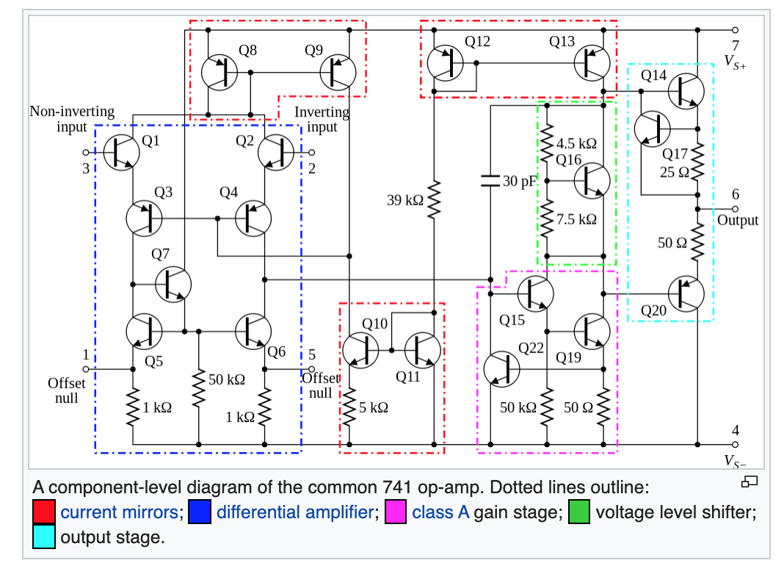
5.1 Operational Amplifier Terminals

Slide 4
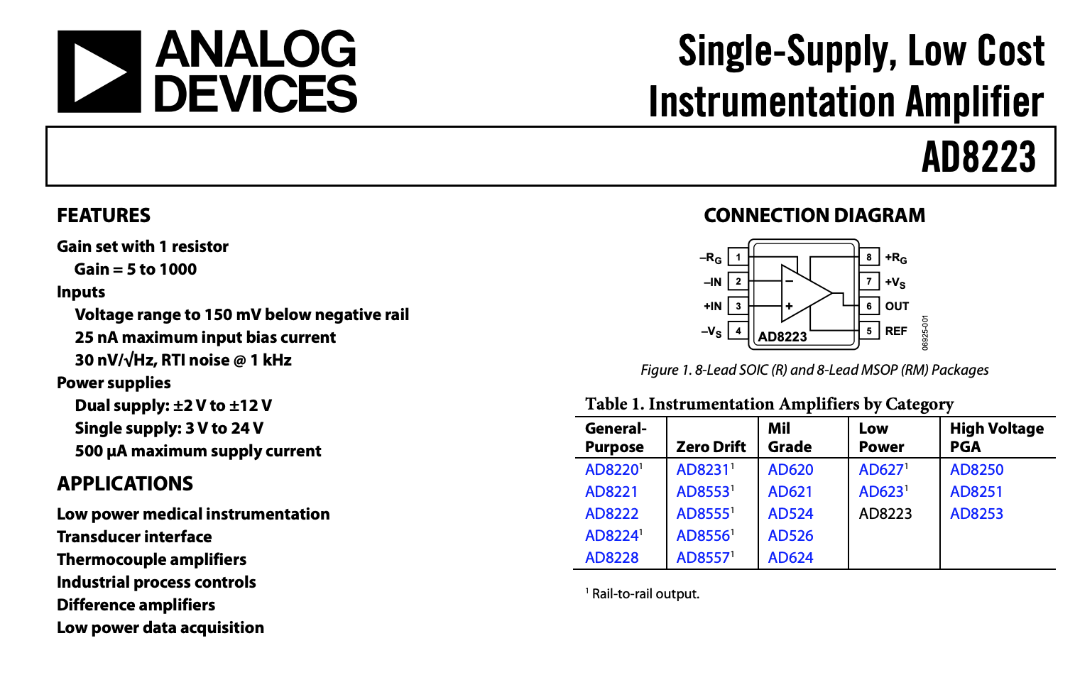
5.1 Operational Amplifier Terminals

Slide 5
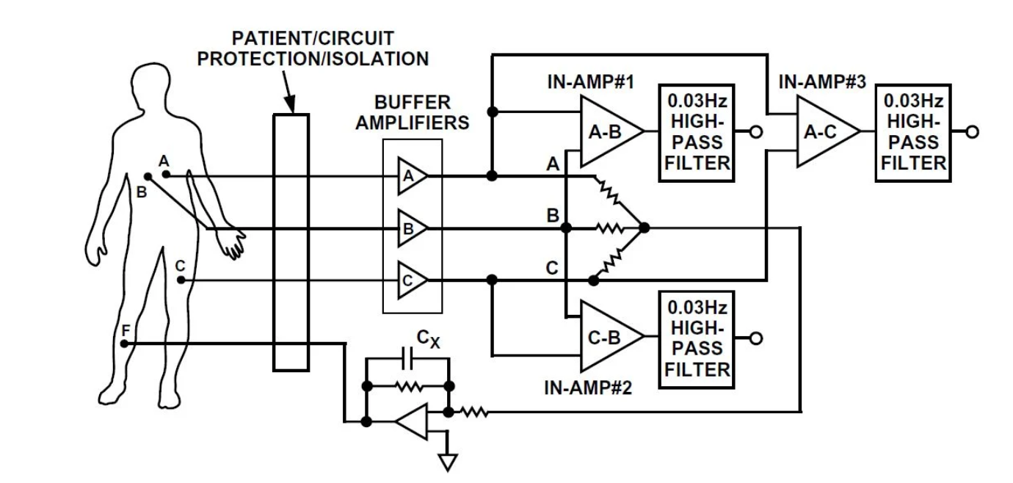
5.1 Operational Amplifier Terminals

Slide 6
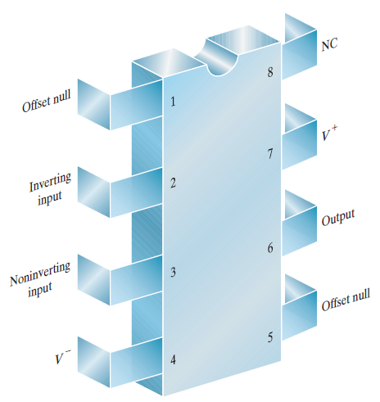
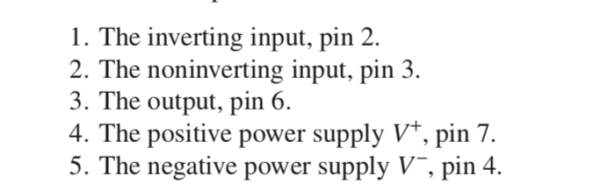
5.1 Operational Amplifier – Important Terminals

Slide 7
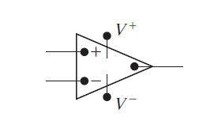
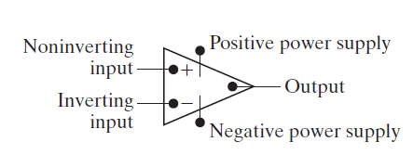
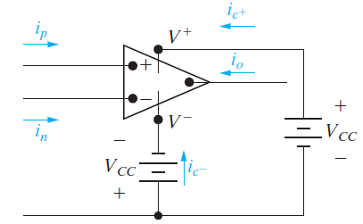
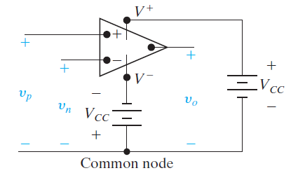
5.2 Terminal Voltages and Currents

Slide 8
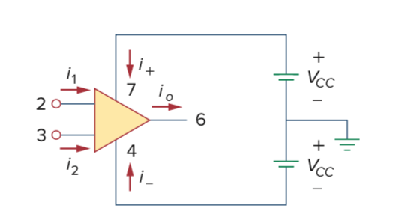
5.2 Terminal Voltages and Currents
-
+

Slide 9
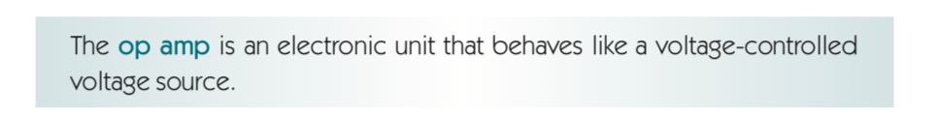
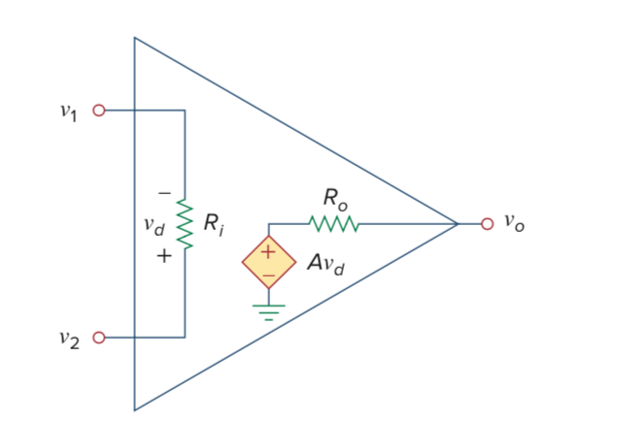
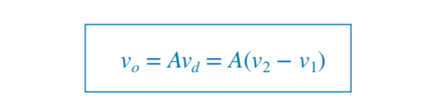

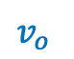
5.2 Terminal Voltages and Currents
-
$v_{o}$
+
’A’ is the open-loop Gain

Slide 10
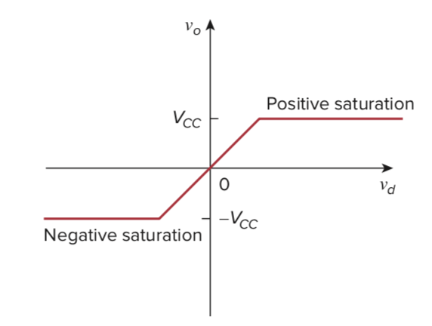
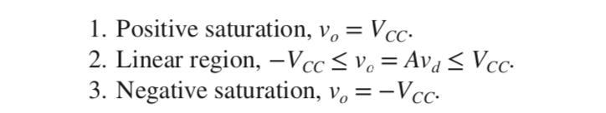
5.2 Terminal Voltages and Currents

Slide 11
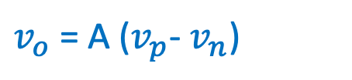
5.2 Terminal Voltages and Currents
$v_{o}$ = A ($v_{p}$- $v_{n}$)

Slide 12
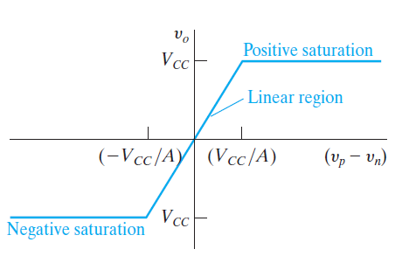
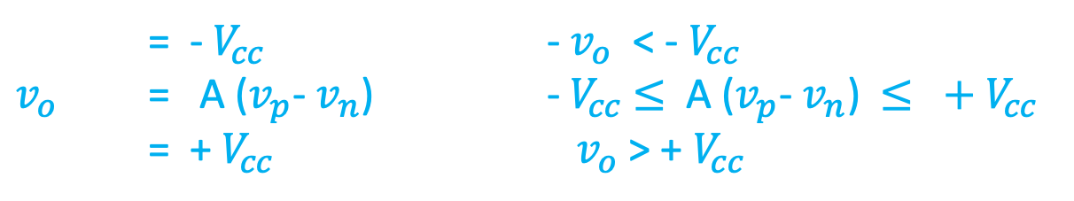
5.2 Terminal Voltages and Currents
= -${ V}_{cc}$ - $v_{o}$ < - $V_{cc}$
$v_{o}$ = A ($v_{p}$- $v_{n}$) - $V_{cc}$ $≤$ A ($v_{p}$- $v_{n}$) $≤$ ${ + V}_{cc}$
= + $V_{cc}$ ${ v}_{o}$ > + $V_{cc}$

Slide 13
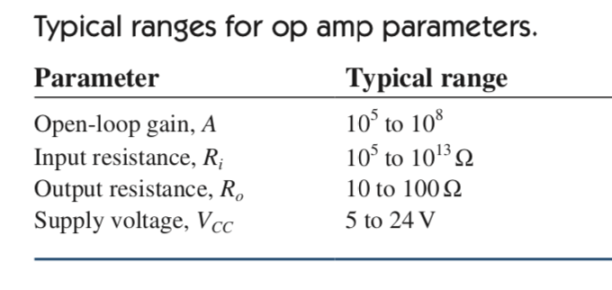

5.2 Terminal Voltages and Currents – Real and Ideal OpAmp
$$Real OpAmp$$

Slide 14
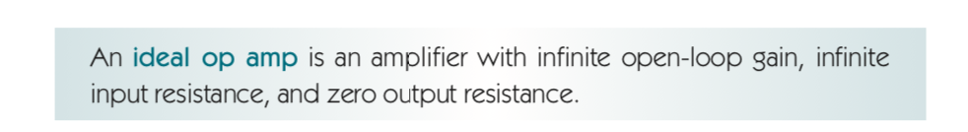
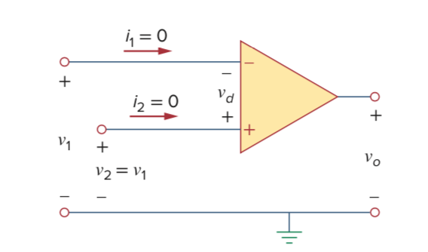
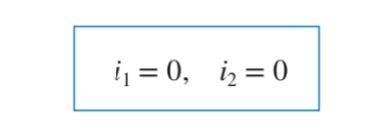
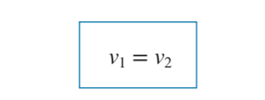
5.2 Terminal Voltages and Currents – Real and Ideal OpAmp

Slide 15
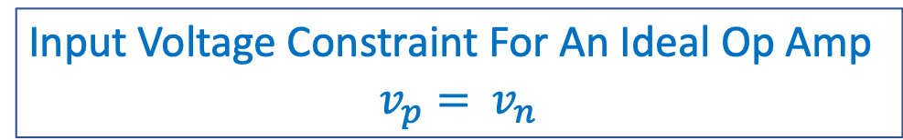
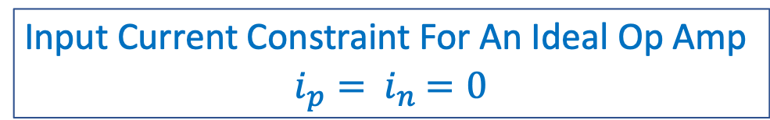


5.2 Terminal Voltages and Currents – Real and Ideal Op Amp
$$i_{p}$$
$$i_{n}$$
Input Voltage Constraint For An Ideal Op Amp
$v_{p}=$ $v_{n}$
Input Current Constraint For An Ideal Op Amp
$i_{p}=$ $i_{n}$ $=0$

Slide 16
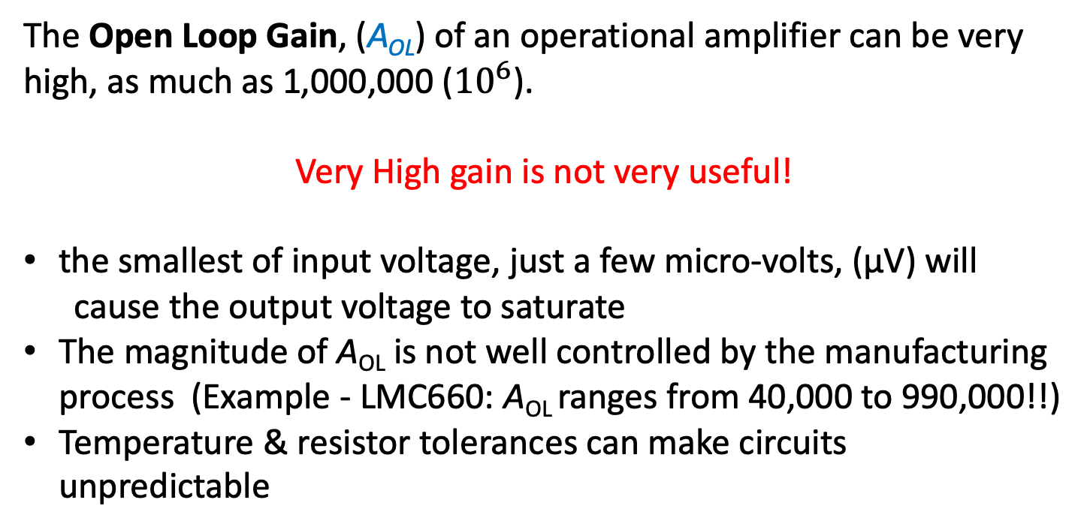
5.2 Terminal Voltages and Currents – Feedback
The Open Loop Gain, (A_{OL}) of an operational amplifier can be very high, as much as 1,000,000 (${10}^{6}$).
Very High gain is not very useful!
the smallest of input voltage, just a few micro-volts, (μV) will
cause the output voltage to saturate
The magnitude of A_{OL} is not well controlled by the manufacturing process (Example - LMC660: A_{OL} ranges from 40,000 to 990,000!!)
Temperature & resistor tolerances can make circuits unpredictable

Slide 17
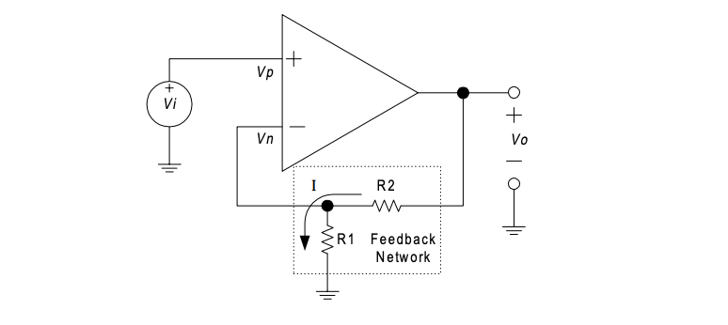
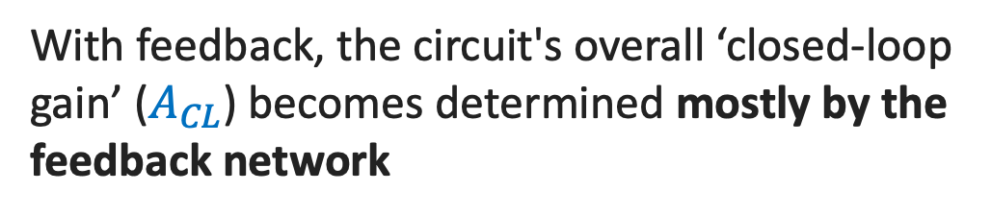
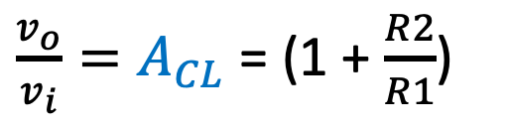
5.2 Terminal Voltages and Currents – Feedback
So, we need some way of controlling the gain. That is what the feedback resistors do
Feedback: applying a portion of the output voltage to the input
Feedback can be either positive or negative
${\frac{v_{o}}{v_{i}}=A}_{CL}$ = (1 + $\frac{R2}{R1}$)
With feedback, the circuit's overall ‘closed-loop gain’ ($A_{CL}$) becomes determined mostly by the feedback network

Slide 18
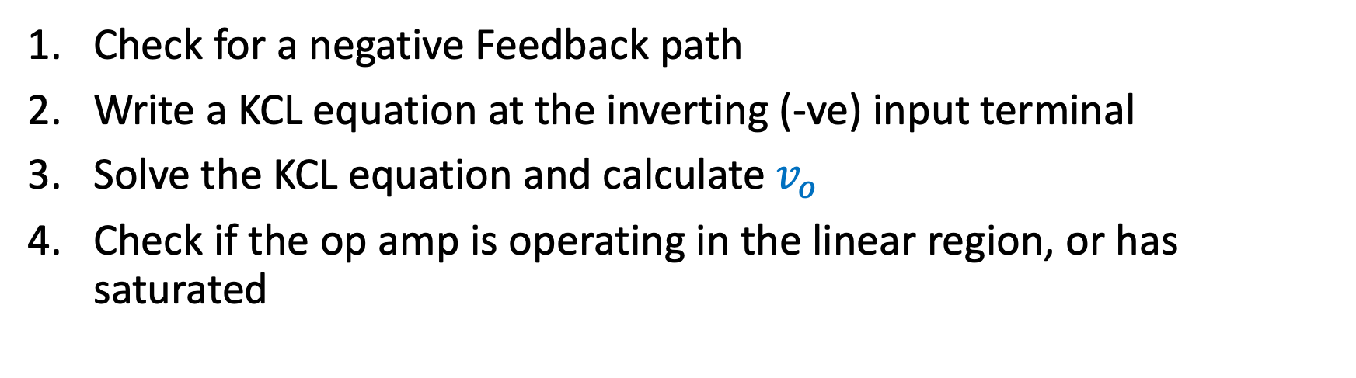
5.2 Terminal Voltages and Currents – Steps for Analyzing a circuit with Ideal Op Amp
Check for a negative Feedback path
Write a KCL equation at the inverting (-ve) input terminal
Solve the KCL equation and calculate $v_{o}$
Check if the op amp is operating in the linear region, or has saturated

Slide 19
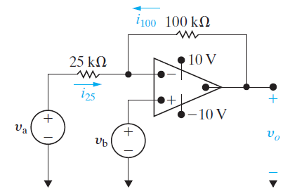
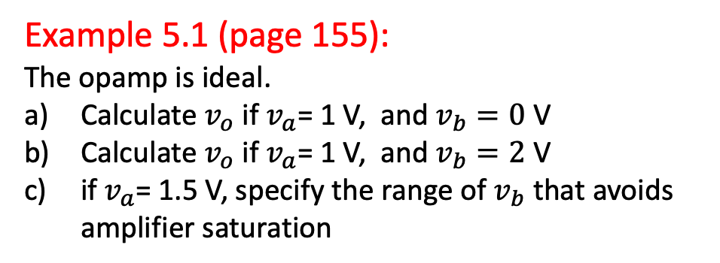
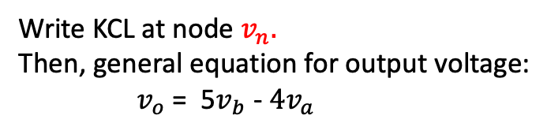
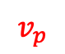
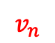
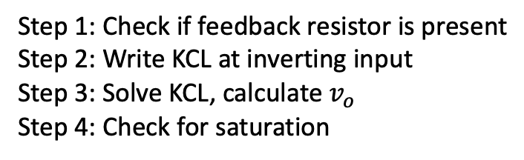
5.2 Terminal Voltages and Currents – Example 5.1: Analyzing an OpAmp Circuit
Example 5.1 (page 155):
The opamp is ideal.
Calculate $v_{o}$ if $v_{a}$= 1 V, and $v_{b}=0 \text{V}$
Calculate $v_{o}$ if $v_{a}$= 1 V, and $v_{b}=\text{2} \text{V}$
if $v_{a}$= 1.5 V, specify the range of $v_{b}$ that avoids amplifier saturation
$$v_{n}$$
$$v_{p}$$
Step 1: Check if feedback resistor is present
Step 2: Write KCL at inverting input
Step 3: Solve KCL, calculate $v_{o}$
Step 4: Check for saturation
Write KCL at node $v_{n}.$
Then, general equation for output voltage:
$v_{o}$ = 5$v_{b}$ - ${4v}_{a}$

Slide 20
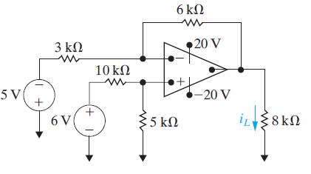
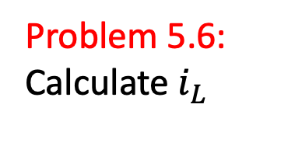
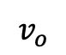
5.2 Terminal Voltages and Currents – Problem 5.6: Analyzing an Op Amp Circuit
Problem 5.6:
Calculate $i_{L}$
$$v_{o}$$

Slide 21
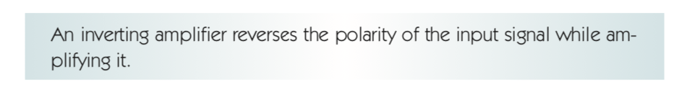
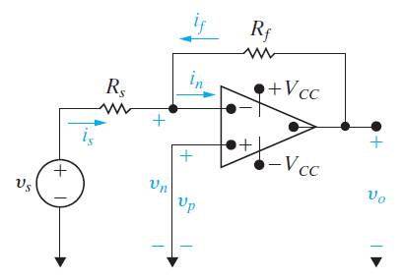
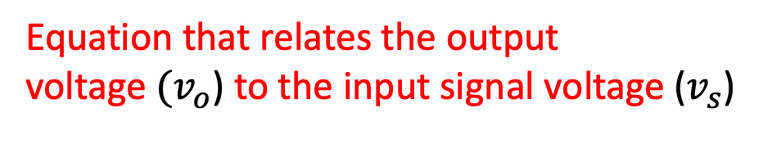

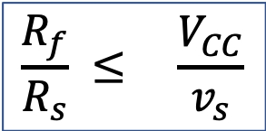
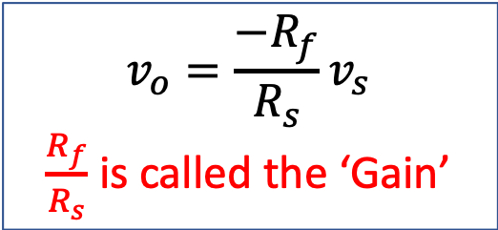
5.3 The Inverting Amplifier Circuit
Equation that relates the output
voltage ${(v}_{o}$) to the input signal voltage ($v_{s}$)
$$v_{o}=\frac{{−R}_{f}}{R_{s}}v_{s}$$
$\frac{R_{f}}{R_{s}}$ is called the ‘Gain’
Range of possible values for $R_{f}$ and $R_{s}$
$$\frac{R_{f}}{R_{s}} ≤ \frac{V_{CC}}{v_{s}}$$

Slide 22
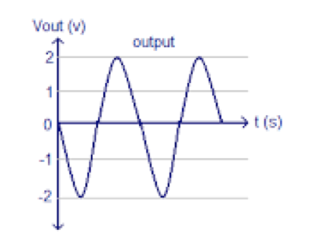
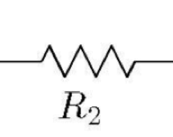
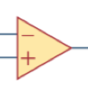
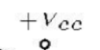
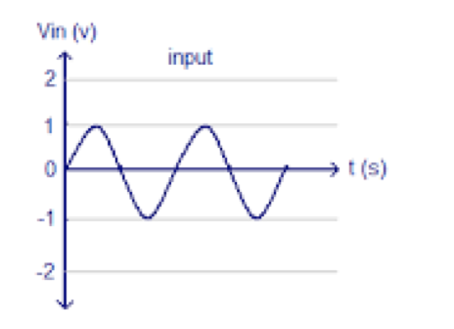





5.3 The Inverting Amplifier Circuit
Gain is
$\frac{R_{2}}{R_{1}}$ = 2

Slide 23


5.3 The Inverting Amplifier Circuit

Slide 24










5.3 The Inverting Amplifier Circuit Example
$$i_{25k}$$
Example:
In the ideal op amp circuit, If $v_{i}$ is 0.5 volts, find:
$v_{o}$ and
the currents in the 10k & 25k resistors.
$$i_{10k}$$
$$v_{n}$$
0.5 v
$$v_{p}$$
$$v_{o}=\frac{{−R}_{f}}{R_{s}}v_{s}$$
Since $\frac{{−R}_{f}}{R_{s}}$ equals -25/10 or -2.5, $v_{o}$ = (0.5 * -2.5), or -1.25 volts
Current, $i_{10k}=\frac{{v_{i}−v}_{n}}{10k}$ which is $\frac{0.5 − 0}{10k}$ or 50 microAmps.
Current, $i_{25k}=\frac{{v_{n}−v}_{o}}{25k}$ which is $\frac{0 −(−1.25)}{25k}$ or 50 microAmps.
Also, $i$ $=\frac{{v_{in}−v}_{out}}{10k+25k}$= $\frac{0.5 −(−1.25)}{35k}$= 50 microAmps
$v_{p}=$ $v_{n}$
$i_{p}=$ $i_{n}$ $=0$

Slide 25

5.3 The Inverting Amplifier Circuit Example 5.2
Example 5.2:
Design an inverting amplifier with a gain of 12. Use +/-15V power supplies and an ideal op amp
What range of input voltages, $v_{s},$allows the op amp in this design to remain in its linear operating region?

Slide 26



5.3 The Inverting Amplifier Circuit Problem 5.10
Problem 5.10:
Find the range of values for σ (the dial setting on the potentiometer) in which the op amp does NOT saturate
Find $i_{o}$ when σ = 0.272
${Define: R}_{\text{σ}}$ = σ * 50k ohms

Slide 27



5.4 The Summing Amplifier Circuit
$v_{o}=− ( \frac{R_{f}}{R_{a}}v_{a}$ + $\frac{R_{f}}{R_{b}}v_{b}$+ $\frac{R_{f}}{R_{c}}v_{c}$)

Slide 28


5.4 The Summing Amplifier Circuit Example 5.3
Example 5.3 (Page 159):
Design a summing amplifier with
output
$v_{o}=− (4v_{a}$ + $v_{b}$+ $5v_{c}$)
Use an ideal op amp with +/-12V
power supplies and a 20k feedback
resistor
if $v_{a}=2 V, v_{c}=−1 V,$find the range of values for $v_{b}$ to stay in linear operation
c) If $v_{a}=2 V, v_{b}=3 V$, $v_{c}=−1 V;$find the highest feedback resistor to stay in linear operation

Slide 29


5.4 The Summing Amplifier Circuit Problem 5.12
Problem 5.12:
What circuit config is shown?
Find $v_{o}$ if $v_{a}=1.2 V, v_{b}=−1.5 V$ and $v_{c}=4 V$
c) find the range of values for $v_{b}$ to stay in linear operation if $v_{a}$ $v_{c}$ are as in b) above

Slide 30

5.4 The Summing Amplifier Circuit Problem 5.15
Problem 5.15:
Design a summing amplifier with
output
$v_{o}=− (8v_{a}$ + ${4v}_{b}$+ $10v_{c}+6v_{d}$)
Use an ideal op amp and a standard feedback resistor from Appendix H. Then choose single resistor or resistor pairs to satisfy design values for $R_{a}$ $R_{b}$ $R_{c}$ $R_{d}$

Slide 31




5.5 The Noninverting Amplifier Circuit
$v_{o}= ( \frac{R_{s}+R_{f}}{R_{s}}$) $v_{g}$
Or
$v_{o}= (1+ \frac{R_{f}}{R_{s}}$) $v_{g}$
$(1+ \frac{R_{f}}{R_{s}}$) is called the ‘Gain’

Slide 32





5.5 The Noninverting Amplifier Circuit

Slide 33




5.5 The Noninverting Amplifier Circuit – Voltage Follower
$v_{o}= (1+ \frac{R_{f}}{R_{s}}$) $v_{g}$
If $R_{f}=0, or$ $R_{s}=∞$
Then, Gain $(1+ \frac{R_{f}}{R_{s}}$) = 1
Voltage follower circuit
The Voltage follower circuit
Isolates one circuit from another

Slide 34


5.5 The Noninverting Amplifier Circuit Example: 5.4
Example 5.4:
Design a noninverting amplifier with
a gain of 6.
If -1.5V $≤$ $v_{g}$ $≤$ 1.5V, what are the smallest power supply values for linear operation

Slide 35


5.5 The Noninverting Amplifier Circuit Problem 5.20
Problem 5.20:
Calculate $v_{o}$when $v_{g}$equals 3 Volts.
find the range of values for $v_{g}$ to stay in linear operation
c) If $v_{g}=5 V$and the feedback resistor is variable, what resistor value will cause the op amp to saturate?

Slide 36




5.6 The Difference Amplifier Circuit
$v_{o}= \frac{{R_{d}(R}_{a}+R_{b})}{R_{a}\left(R_{c}+R_{d}\right)}$ $v_{b}$ - $\frac{R_{b}}{R_{a}}$ $v_{a}$
$If \frac{R_{a}}{R_{b}}$ = $\frac{R_{c}}{R_{d}}, then$
$v_{o}= \frac{R_{b}}{R_{a}}$ ($v_{b}−v_{a}$)

Slide 37


5.4 The Difference Amplifier Circuit Example: 5.5
Example 5.5:
Design a difference amplifier with a gain
of 8, using an ideal op amp and +/- 8V VCC
If $v_{a}$ = 1 V, what is the range of values for $v_{b}$ for linear operation

Slide 38

5.6 The Difference Amplifier Circuit Problem: 5.28
Problem 5.28:
Design a difference amplifier with
output
$v_{o}={3v}_{b}−4v_{a}$
Given:
$R_{in}$ for source $v_{b}$ is 470k
$R_{in}$ for source $v_{a}$ is 22k, when $v_{o}$ is 0.
From Appendix H, choose single resistor or resistor pairs to satisfy design values for $R_{a}$ $R_{b}$ $R_{c}$ $R_{d}$

Slide 39

5.4 The Difference Amplifier Circuit - CMRR
An ideal differential amplifier amplifies only the differential mode portion of the input voltage, and eliminates the common-mode portion of the input voltage.
The common mode rejection ratio (CMRR) of a differential amplifier indicates its ability to reject common-mode signals, i.e. those signals that appear simultaneously on both inputs.
$CMRR$ = $\frac{A_{dm}}{A_{cm}}$

Slide 40



5.4 The Difference Amplifier Circuit – Differential- & Common-mode inputs
Definition:
$v_{dm}=v_{b}−v_{a}$ (Differential). $A_{dm}$ -> Differential-mode gain
$v_{cm}={(v}_{a}+v_{b}$)/2 (Common-mode) $A_{cm}$ -> Common-mode gain
Output equation:
$$v_{o}=A_{cm}v_{cm}+{A_{dm}v}_{dm}$$
If: ${R_{c}= R}_{a} and R_{d}= R_{b}$
Then (for an ideal differential amplifier):
${ A}_{cm}$ is zero (i.e. NO CM GAIN!) and
${ v}_{o}=\frac{R_{b}}{R_{a}}v_{dm}$

Slide 41

5.4 The Difference Amplifier Circuit - CMRR
If a differential input change of Y volts produces a change of 1 V at the output, and a common-mode change of X volts produces a similar change of 1 V, then the CMRR is X/Y.
Say, $v_{cm}$ of 5000 mV gives a 1 Volt output,
and $v_{dm}$ of 100 mV also gives a 1 Volt output,
then CMRR is 50.
Higher the CMRR, better the differential-mode performance!
$A_{cm}$ is often not zero because of resistance mismatches, or because the op-amp is non-ideal

Slide 42



Extra: Cascaded Op Amp Circuits

Slide 43



Extra: Cascaded Op Amp Circuits Example of a 2-stage cascade
$v_{o}= (1+ \frac{R_{f}}{R_{s}}$) $v_{g }$at each stage.
Total gain is: $A_{1}∗ A_{2}$
$(or$5 * 3.5 = 17.5)
So, $v_{o}$= 17.5 * 20mV = 350 mV

